Slide 1
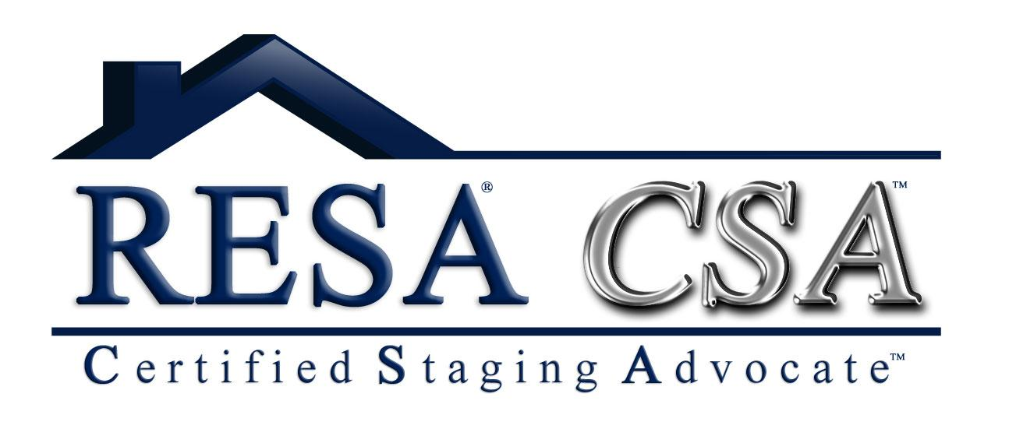
Staging to Sell, What Every Agent Should Know 3-Hour CE Course for Agents
®
A real estate professional completing
^{this class will understand:}
How to avoid the risk of breach of duty and negligence claims by offering staging as a resource to their clients
How to protect their clients from litigation by knowing what questions to ask a stager
How to use home staging to reduce disclosure issues
Standard staging contract clauses
The cost and value of home staging, ROI factors
Importance of leveraging marketing efforts with staging, photos and Internet presence
Course comes with over 50-staging tips that agents can use immediately
The common contract clauses that professional stagers use and what your clients need to know about them
How the entire pre-market staging process will benefit your client and secure your relationship as a true advocate for their best interest
Liz Pensiero, RESA-PRO
RESA Approved Instructor
Phone: (203) 940-0338
Date: June 8, 2022
Time: 9:30-12:30
Location: Waterstone on High Ridge
215 High Ridge Road, Stamford
Cost: $35.00 per person
Register: RSVPstagingclass@yahoo.com
Please email with interest to above address
Limited to 25 agents so register early!
Payment accepted via Venmo, cash or check
Agents Earn The
RESA Certified Staging Advocate Designation
Please cancel 48-hours in advance to qualify for a refund. Funds may not be transferred from one course to another. No refunds will be issued for late arrival, and no CE will be given.
CE Provider #RCE.1084

